Slide 2

APPROVED OF GOD contingent on our
STUDY
2 Timothy 2:15
Psalm 119:105,130

Slide 3
Ignorance of god’s word
MEANS WE ARE IN DARKNESS
Why?
Bible is BASIS of ALL FAITH
Romans 10:17
And the GROUND of ALL HOPE
Romans 15:4

Slide 4
Many read the bible for a lifetime-
AND STILL KNOW LITTLE ABOUT IT!
Why?
It is because they have never learned to STUDY!
Just READ!

Slide 5
Several methods:
“Fall open at random method”
Matthew 27:5 “went and hanged himself”
Luke 10:37 “Go and do likewise.”
John 13:27 “What you do, do quickly!”
“Joseph son of Jacob” “Joseph husband of Mary”
“Joseph of Arimathea”
Saul trying to kill David– Saul persecuting church
NOT a good method of Bible Study!

Slide 6
Several methods:
“BOOK BY BOOK – COVER TO COVER”
Order of the books arranged by MEN – not necessarily chronological
Return of Israel in Ezra & Nehemiah BEFORE record of captivity in Ezekiel & Daniel
This is NOT an EFFECTIVE method of Bible Study.

Slide 7
Several methods:
“ANALYTICAL METHOD”
Get a General View of Bible

Slide 8
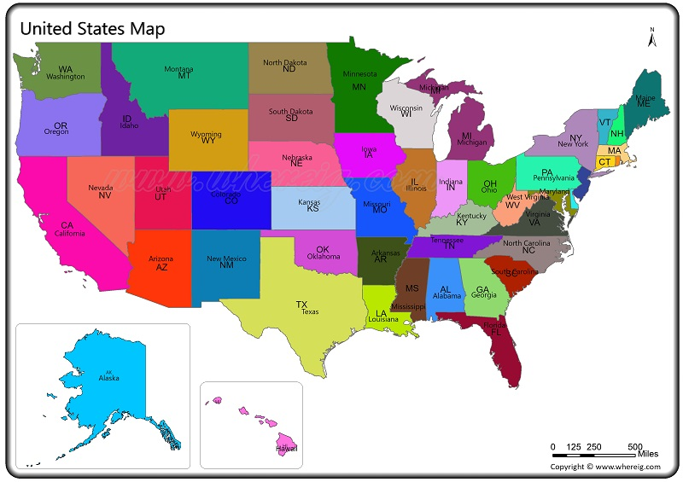

Slide 9

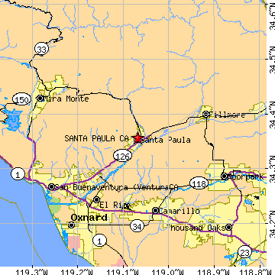

Slide 10
Several methods:
“ANALYTICAL METHOD”
Get a General View of Bible
Two Testaments – OLD and NEW
Covering THREE DISPENSATIONS
PATRIARCHAL, MOSAIC, GOSPEL
Which one pertains to OUR LIVES TODAY?

Slide 11
Simple rules for beneficial bible study
SPEAKER – God or Satan – Inspired man or enemy of God
Satan is a liar – John 8:44
TO WHOM WRITTEN – Not all of the Bible is directly applicable to US
Don’t have to build an ark – Genesis 6
Don’t have to go to Nineveh! Jonah
Don’t have to go to Jerusalem for Feasts.
Don’t have to kill all who violate certain laws.
These commands were not given to US!

Slide 12
Simple rules for beneficial bible study
STUDY EACH PASSAGE IN ITS PROPER CONTEXT-
Don’t give it a meaning that the author never intended!
Colossians 2:21 to prove some things are prohibited!
John 13:7b to prove we will understand death someday!
1 Corinthians 13:12 to prove we will recognize those who have passed on whenever we join them in heaven!
ALL of these ABUSES of the Scriptures do not consider the SETTING in which these verses appear

Slide 13
Simple rules for beneficial bible study
APPROACH THE BIBLE WITH AN OPEN & HONEST HEART-
IF we have MIND MADE UP, we will USUALLY find what we are looking for!
Man with MIND MADE UP is NOT a FIT BIBLE STUDENT
Too many study the way Balak approached Balaam
Numbers 22-24 Balak wanted Balaam to CURSE ISRAEL!
THREE TIMES he blessed them!
We must be satisfied with what the Lord Says – not continue to look for some LOOPHOLE His word!

Slide 14
Simple rules for beneficial bible study
Acts 17:10,11 Berea commended for their approach to preaching of the Gospel- “received the word with all readiness, and searched the Scriptures daily”
We MUST be willing to INVESTIGATE what the Scriptures say before we decide what to BELIEVE and DO!
“No matter if what I learn contradicts everything I have always believed or practiced, I will conform my life to the truth found in the pages of God’s word.”

Slide 15
Without this attitude, study is pointless!
We will be found like balak moving from mountain to mountain trying to find some way to justify what we want to believe or practice!

